Slide 1
What is Functional Dependency??
Functional Dependency is a constraint between two sets of attributes in relation to a database.
A functional dependency is denoted by an arrow (→). If an attribute A functionally determines B, then it is written as A → B.
it helps in preventing data redundancy and gets to know about bad designs.
To understand the concept thoroughly, let us consider P is a relation with attributes A and B. Functional Dependency is represented by -> (arrow sign)
For example, employee_id → name means employee_id functionally determines the name of the employee.
As another example in a timetable database, {student_id, time} → {lecture_room}, student ID and time determine the lecture room where the student should be.

Slide 2
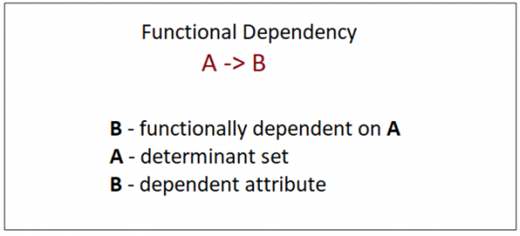

Slide 3
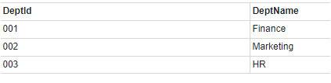
The following is an example that would make it easier to understand functional dependency −
We have a <Department> table with two attributes − DeptId and DeptName.
DeptId = Department ID
DeptName = Department Name
The DeptId is our primary key. Here, DeptId uniquely identifies the DeptName attribute. This is because if you want to know the department name, then at first you need to have the DeptId.
Therefore, the above functional dependency between DeptId and DeptName can be determined as DeptId is functionally dependent on DeptName
DeptId -> DeptName

Slide 4
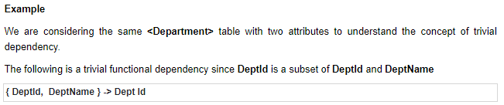
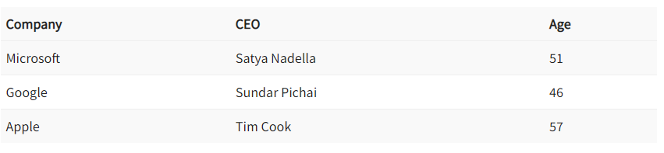
Types of Functional Dependency
Trivial Functional Dependency
- It occurs when B is a subset of A in −
Non-Trivial Functional Dependency
-It occurs when B is not a subset of A in −
(Company} -> {CEO} (if we know the Company, we knows the CEO name)
But CEO is not a subset of Company, and hence it’s non-trivial functional dependency.

Slide 5
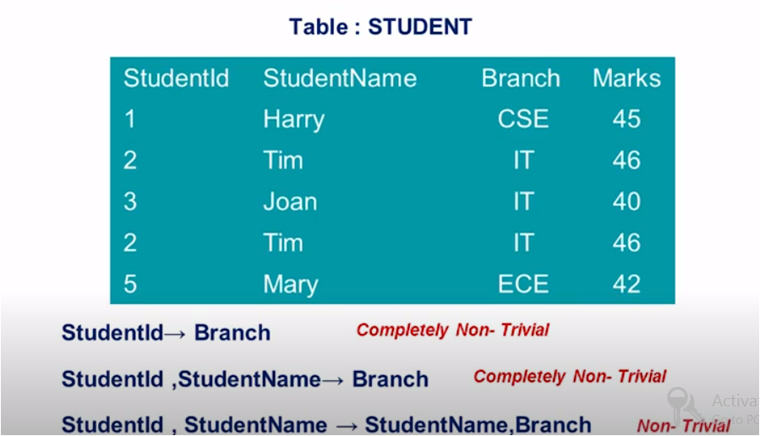
Completely Non-Trivial Functional Dependency-
- It occurs when A intersection B is null in −
https://www.youtube.com/watch?v=yTnvYiyEvho

Slide 6
Armstrong’s Axioms Property of Functional Dependency
Armstrong’s Axioms property was developed by William Armstrong in 1974 to reason about functional dependencies.
The property suggests rules that hold true if the following are satisfied:
Transitivity If A->B and B->C, then A->C i.e. a transitive relation.
Reflexivity A-> B, if B is a subset of A.
Augmentation The last rule suggests: AC->BC, if A->B

Slide 7
https://minigranth.in/dbms-tutorial/closure-of-functional-dependency

Slide 8
Normalization
Unit 4

Slide 9
Normalization
The process of normalization is a formal method that identifies relational schemas based upon their primary or candidate keys and the functional dependencies that exists amongst their attributes.
Normalization is primarily a tool to validate and improve a logical design so that it satisfies certain constraints that avoid unnecessary duplication of data.
Normalization is the process of decomposing relation with anomalies to produce smaller, well-structured relations.
Normalisation should remove redundancy, but not at the expense of data integrity.

Slide 10
Transforming data from a problem into relations while ensuring data integrity and eliminating data redundancy.
Data integrity : consistent and satisfies data constraint rules
Data redundancy: if data can be found in two places in a single database (direct redundancy) or calculated using data from different parts of the database (indirect redundancy) then redundancy exists.
Normalisation should remove redundancy, but not at the expense of data integrity.

Slide 11
introduction
Normalization is the process of minimizing redundancy from a relation or set of relations. Redundancy in relation may cause insertion, deletion and updation anomalies. So, it helps to minimize the redundancy in relations. Normal forms are used to eliminate or reduce redundancy in database tables.
Database normalization is the process of organizing the attributes of the database to reduce or eliminate data redundancy (having the same data but at different places) .
Problems because of data redundancy Data redundancy unnecessarily increases the size of the database as the same data is repeated in many places. Inconsistency problems also arise during insert, delete and update operations.

Slide 12
Example
St. Id | St.Name | Marks | Dept.Name | Room No | Building Name
1 | Anil | 5 | CSE | 501 | B1
2 | Sunil | 8 | CSE | 501 | B1
3 | Faira | 7 | Civil | 201 | B3
4 | Kumar | 9 | Fashion Design | 709 | B7
5 | Tanu | 7 | Fashion Design | 709 | B7
Redundant data
Issues:
1. Updation anomaly
2. Deletion anomaly
3. Insertion anomaly

Slide 13
Insertion anomaly
St. Id | St.Name | Marks | Dept.Name | Room No | Building Name
1 | Anil | 5 | CSE | 501 | B1
2 | Sunil | 8 | CSE | 501 | B1
3 | Faira | 7 | Civil | 201 | B3
4 | Kumar | 9 | Fashion Design | 709 | B7
5 | Tanu | 7 | Fashion Design | 709 | B7
* | * | * | ECE | 801 | B2
If a new dept. information needs to be added to the existing table then the condition is that it needs at least one student information.
We cant mention the values of St.Id, St. Name and Marks as NULL( the primary key: St.Id cant be null)

Slide 14
Updation anomaly
St. Id | St.Name | Marks | Dept.Name | Room No | Building Name
1 | Anil | 5 | CSE | 501 502 | B1
2 | Sunil | 8 | CSE | 501 | B1
3 | Faira | 7 | Civil | 201 | B3
4 | Kumar | 9 | Fashion Design | 709 | B7
5 | Tanu | 7 | Fashion Design | 709 | B7
If the room no of the CSE dept. changes from 501 to 502. then the updation needs to be made in all the records.
For example there is going to be150 records that are for CSE dept. then all the 150 records need to get updated.

Slide 15
Deletion anomaly
If suppose The St.Id - 3 got TC, Dept. doesn’t need to be deleted. Since in the above mentioned table the Civil dept. has only one student record. If the student record is deleted there is incomplete data in the relation table.
St. Id | St.Name | Marks | Dept.Name | Room No | Building Name
1 | Anil | 5 | CSE | 501 | B1
2 | Sunil | 8 | CSE | 501 | B1
3 | Faira | 7 | Civil | 201 | B3
4 | Kumar | 9 | Fashion Design | 709 | B7
5 | Tanu | 7 | Fashion Design | 709 | B7

Slide 16
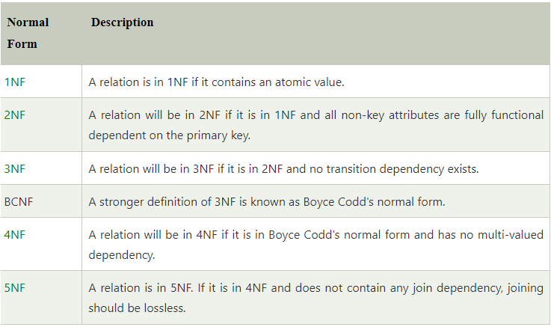
Types of normalization

Slide 17
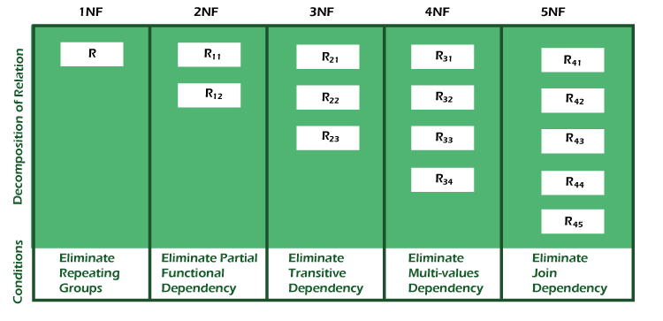

Slide 18
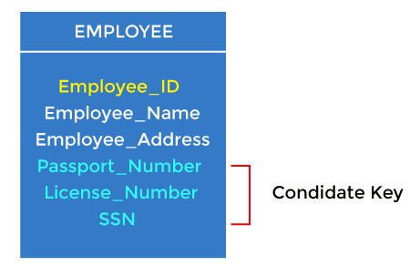
2. Candidate key
A candidate key is an attribute or set of attributes that can uniquely identify a tuple.
Except for the primary key, the remaining attributes are considered a candidate key. The candidate keys are as strong as the primary key.
For example: In the EMPLOYEE table, id is best suited for the primary key. The rest of the attributes, like SSN, Passport_Number, License_Number, etc., are considered a candidate key.
Attributes which are parts of any candidate key of relation are called as prime attribute, others are non-prime attributes.

Slide 19
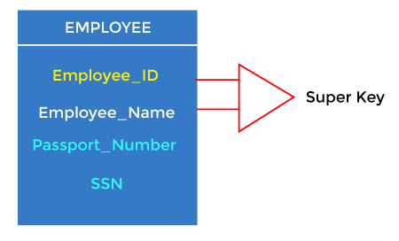
3. Super Key Super key is an attribute set that can uniquely identify a tuple. A super key is a superset of a candidate key.

Slide 20
Advantages of Normalization
Normalization helps to minimize data redundancy.
Greater overall database organization.
Data consistency within the database.
Much more flexible database design.
Enforces the concept of relational integrity.
Disadvantages of Normalization
You cannot start building the database before knowing what the user needs.
The performance degrades when normalizing the relations to higher normal forms, i.e., 4NF, 5NF.
It is very time-consuming and difficult to normalize relations of a higher degree.
Careless decomposition may lead to a bad database design, leading to serious problems.

Slide 21
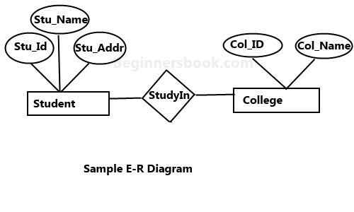
FIRST NORMAL FORM
Stu. Id | Stu.Name | Stu.Addr
1 | Anil | Bangalore,India
2 | Sunil | Punjab,India
3 | Giri | Chennai,India
4 | Viny | Raja.,India
ER to Relational table
Converted to INF
Stu. Id | Stu.Name | State | Country
1 | Anil | Bangalore | India
2 | Sunil | Punjab | India
3 | Giri | Chennai | India
4 | Viny | Raja. | India
Atomic domains
All column should contain from the same domain
Each column should have unique names
No duplicate rows
No ordering to rows and columns

Slide 22
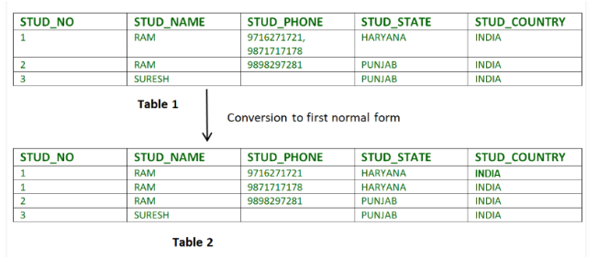
If a relation contain composite or multi-valued attribute, it violates first normal form or a relation is in first normal form if it does not contain any composite or multi-valued attribute. A relation is in first normal form if every attribute in that relation is singled valued attribute.

Slide 23
Functional dependencies
Functional Dependency (FD) is a constraint that determines the relation of one attribute to another attribute in a Database Management System (DBMS). Functional Dependency helps to maintain the quality of data in the database. ... The functional dependency of X on Y is represented by X → Y.
Prime attribute − An attribute, which is a part of the candidate-key, is known as a prime attribute.
Non-prime attribute − An attribute, which is not a part of the prime-key, is said to be a non-prime attribute.
If we follow second normal form, then every non-prime attribute should be fully functionally dependent on prime key attribute.
That is, if X → A holds, then there should not be any proper subset Y of X, for which Y → A also holds true.

Slide 24
SECOND NORMAL FORM
Rules for 2NF
A relation can be converted to 2NF only when it is already in the 1NF form
No partial dependencies in the relation
What is partial dependencies?
When two or more primary keys in one table(candidate key)
R(A, B,C,D,E,F)
FD(A->B,B->C, C->D,D->E)
Partial Dependency occurs when a non-prime attribute is functionally dependent on part of a candidate key.

Slide 25
STUD_NO COURSE_NO COURSE_FEE
1 C1 1000
2 C2 1500
1 C4 2000
4 C3 1000
4 C1 1000
2 C5 2000
Here, COURSE_FEE cannot alone decide the value of COURSE_NO or STUD_NO; COURSE_FEE together with STUD_NO cannot decide the value of COURSE_NO; COURSE_FEE together with COURSE_NO cannot decide the value of STUD_NO; Hence, COURSE_FEE would be a non-prime attribute, as it does not belong to the one only candidate key {STUD_NO, COURSE_NO} ; But, COURSE_NO -> COURSE_FEE, i.e., COURSE_FEE is dependent on COURSE_NO, which is a proper subset of the candidate key.
Non-prime attribute COURSE_FEE is dependent on a proper subset of the candidate key, which is a partial dependency and so this relation is not in 2NF.

Slide 26
To convert the above relation to 2NF, we need to split the table into two tables such as : Table 1: STUD_NO, COURSE_NO Table 2: COURSE_NO, COURSE_FEE
Table 1 Table 2
STUD_NO COURSE_NO COURSE_NO COURSE_FEE
1 C1 C1 1000
2 C2 C2 1500
1 C4 C3 1000
4 C3 C4 2000
4 C5 C5 2000
2NF tries to reduce the redundant data getting stored in memory. For instance, if there are 100 students taking C1 course, we don’t need to store its Fee as 1000 for all the 100 records, instead, once we can store it in the second table as the course fee for C1 is 1000

Slide 27
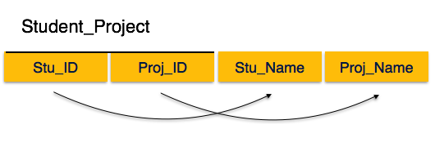
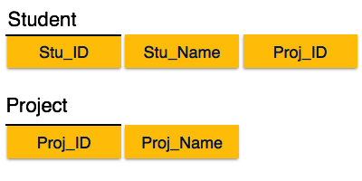
Another Example
Stu_Name and Proj_Name must be dependent upon both and not on any of the prime key attribute individually. But we find that Stu_Name can be identified by Stu_ID and Proj_Name can be identified by Proj_ID independently. This is called partial dependency, which is not allowed in Second Normal Form.
Partial Dependency occurs when a non-prime attribute is functionally dependent on part of a candidate key.

Slide 28
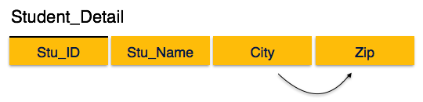
Third normal form
For a relation to be in Third Normal Form, it must be in Second Normal form and the following must satisfy −
No non-prime attribute is transitively dependent on prime key attribute.
For any non-trivial functional dependency, X → A, then either −
X is a superkey or, A is prime attribute.
The non key attributes must be functionally dependent on candidate keys.
There can be no interdependencies among non key attributes.
3NF is used to reduce the data duplication. It is also used to achieve the data integrity.
It should be in 2NF
There should be no transitive function in FD
A->b B->c A->c via B
If there is no transitive dependency for non-prime attributes, then the relation must be in third normal form.

Slide 29
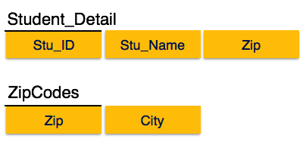
For any non-trivial functional dependency, X → A, then either −
X is a superkey or, A is prime attribute.
We find that in the above Student_detail relation, Stu_ID is the key and only prime key attribute. We find that City can be identified by Stu_ID as well as Zip itself.
Neither Zip is a superkey nor is City a prime attribute. Additionally, Stu_ID → Zip → City, so there exists transitive dependency.

Slide 30
example
BOOK ID | GENRE ID | GENRE TYPE | PRICE
1 | 5 | SCIENCE | 30
2 | 4 | MATHS | 35
3 | 3 | SCIENCE | 25
4 | 2 | PHYSICS | 30
[ BOOK ID]->[GENRE ID]
[GENREID]->[GENRE TYPE]
[BOOK ID]->[GENRE TYPE] VIA[ GENRE ID]
transitive dependency

Slide 31
Third normal form contd.
Book id | Genre id | Price
1 | 5 | 30
2 | 4 | 35
3 | 3 | 25
4 | 2 | 30
Genre id | Genre type
5 | SCIENCE
4 | MATHS
3 | SCIENCE
2 | PHYSICS
The non prime attributes are fully functionally dependent and also it satisfy the no transitive property

Slide 32
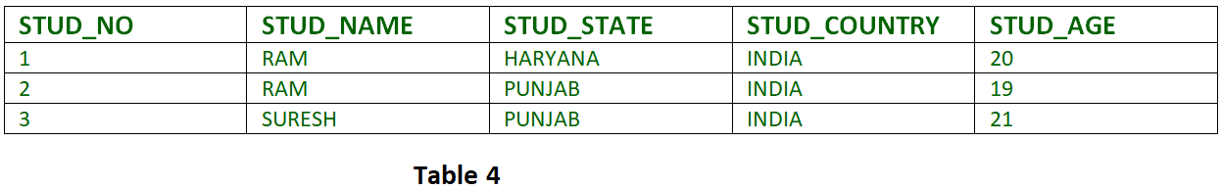
Another example for third normalization
FD set: {STUD_NO -> STUD_NAME, STUD_NO -> STUD_STATE, STUD_STATE -> STUD_COUNTRY, STUD_NO -> STUD_AGE} Candidate Key: {STUD_NO}
For this relation in table 4, STUD_NO -> STUD_STATE and STUD_STATE -> STUD_COUNTRY are true. So STUD_COUNTRY is transitively dependent on STUD_NO. It violates the third normal form. To convert it in third normal form, we will decompose the relation STUDENT (STUD_NO, STUD_NAME, STUD_PHONE, STUD_STATE, STUD_COUNTRY_STUD_AGE) as: STUDENT (STUD_NO, STUD_NAME, STUD_PHONE, STUD_STATE, STUD_AGE) STATE_COUNTRY (STATE, COUNTRY)

Slide 33
Boyce codd normal form/3.5 NF
It is in 3NF
Boyce-Codd Normal Form (BCNF) is an extension of Third Normal Form on strict terms. BCNF states that −
For any non-trivial functional dependency, X → A, X must be a super-key.
In the below image, Stu_ID is the super-key in the relation Student_Detail and Zip is the super-key in the relation ZipCodes. So,
Stu_ID → Stu_Name, Zip and
Zip → City
Which confirms that both the relations are in BCNF.

Slide 34
Super key vs CANDIDATE KEY
Emp_SSN Emp_Number Emp_Name
--------- ---------- --------
123456789 226 Steve
999999321 227 Ajeet
888997212 228 Chaitanya
777778888 229 Robert
Super keys: The above table has following super keys. All of the following sets of super key are able to uniquely identify a row of the employee table.
{Emp_SSN}
{Emp_Number}
{Emp_SSN, Emp_Number}
{Emp_SSN, Emp_Name}
{Emp_SSN, Emp_Number, Emp_Name}
{Emp_Number, Emp_Name}
Candidate Keys: As I mentioned in the beginning, a candidate key is a minimal super key with no redundant attributes.
The following two set of super keys are chosen from the above sets as there are no redundant attributes in these sets.
{Emp_SSN}
{Emp_Number}
Primary key
Emp SSN

Slide 35
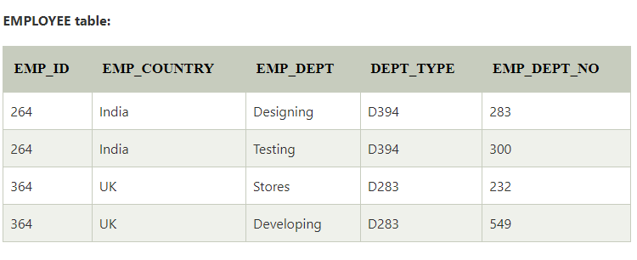
In the above table Functional dependencies are as follows:
EMP_ID → EMP_COUNTRY
EMP_DEPT → {DEPT_TYPE, EMP_DEPT_NO}
Candidate key: {EMP-ID, EMP-DEPT}
The table is not in BCNF because neither EMP_DEPT nor EMP_ID alone are keys.
To convert the given table into BCNF, we decompose it into three tables:

Slide 36
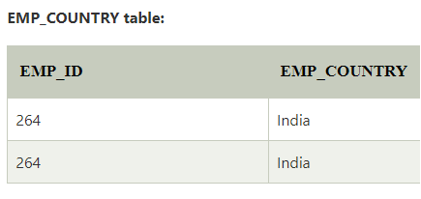
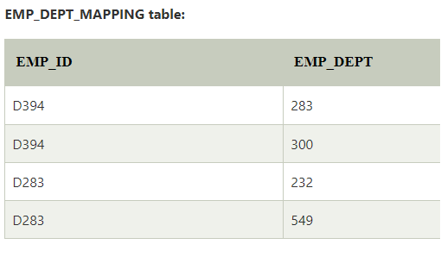
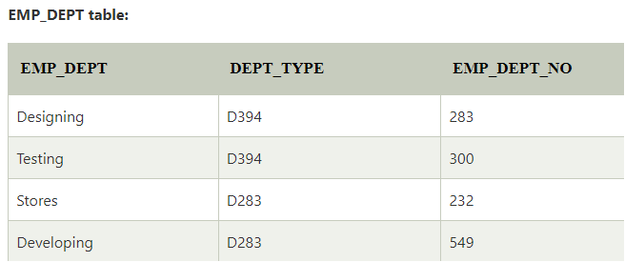
Functional dependencies:
EMP_ID → EMP_COUNTRY
EMP_DEPT → {DEPT_TYPE, EMP_DEPT_NO}
Candidate keys:
For the first table: EMP_ID For the second table: EMP_DEPT For the third table: {EMP_ID, EMP_DEPT}
Now, this is in BCNF because left side part of both the functional dependencies is a key.

Slide 37
BCNF Decomposition
STD | COURSE | TEACHER
Pinky | DBMS | PRIYA
LUCKY | DBMS | MADHU
DEEPU | COA | BHANU
BANNU | COA | BHANU
JESI | DBMS | MADHU
KEY: { STD, COURSE}
{STD,COURSE}-> TEACHER (IS NOT A SUPER KEY)

Slide 38
Decomposition Contd.
STD | COURSE
Pinky | DBMS
LUCKY | DBMS
DEEPU | COA
BANNU | COA
JEANANN | DBMS
COURSE | TEACHER
DBMS | PRIYA
DBMS | MADHU
COA | BAHNU
X->Y
X->Y

Slide 39
Multivalued dependency
bike_model | manuf_year | color
M1001 | 2007 | Black
M1001 | 2007 | Red
M2012 | 2008 | Black
M2012 | 2008 | Red
M2222 | 2009 | Black
M2222 | 2009 | Red
Multivalued dependency occurs when there are more than one independent multivalued attributes in a table.
For example: Consider a bike manufacture company, which produces two colors (Black and white) in each model every year.
Here columns manuf_year and color are independent of each other and dependent on bike_model.
In this case these two columns are said to be multivalued dependent on bike_model. These dependencies can be represented like this:
bike_model ->> manuf_year
bike_model ->> color

Slide 40
Fourth normal form (4NF)
A relation will be in 4NF if it is in Boyce Codd normal form and has no multi-valued dependency.
For a dependency A → B, if for a single value of A, multiple values of B exists, then the relation will be a multi-valued dependency.
Student
STU_ID | COURSE | HOBBY
21 | Computer | Dancing
21 | Math | Singing
34 | Chemistry | Dancing
74 | Biology | Cricket
59 | Physics | Hockey
The given STUDENT table is in 3NF, but the COURSE and HOBBY are two independent entity. Hence, there is no relationship between COURSE and HOBBY.
In the STUDENT relation, a student with STU_ID, 21 contains two courses, Computer and Math and two hobbies, Dancing and Singing. So there is a Multi-valued dependency on STU_ID, which leads to unnecessary repetition of data.
So to make the above table into 4NF, we can decompose it into two tables:

Slide 41
Fourth normal form
Keys and multivalued dependencies
4NF eliminates independent many to one relations between columns
A relation must first be in BCNF
A given relation may not contain more than one multivalued attributes.

Slide 42
STU_ID | COURSE
21 | Computer
21 | Math
34 | Chemistry
74 | Biology
59 | Physics
STUDENT_COURSE
STU_ID | HOBBY
21 | Dancing
21 | Singing
34 | Dancing
74 | Cricket
59 | Hockey
STUDENT_HOBBY

Slide 43
eXAMPLE
STD ID | SUBJECT | ACTIVITY
100 | MUSIC | SWIMMING
100 | ACCOUNTING | SWIMMING
100 | MUSIC | TENNIS
100 | ACCOUNTING | TENNIS
150 | MATHS | JOGGING
Many std.id have same subject
Many std.id have same activity
Thus violates 4NF

Slide 44
DECOMPOSITION
STU. ID | SUBJECT
100 | MUSIC
100 | ACCOUNTING
150 | MATHS
STU. ID | ACTIVITY
100 | SWIMMING
100 | TENNIS
150 | JOGGING
Old Scheme → {STU.ID, SUBJECT, ACTIVITY}
New Scheme → {STU.ID, SUBJECT}
New Scheme → {STU.ID, ACTIVITY}

Slide 45
EXERCISE 1 (convert BCNF to 4NF)
Movie
ScreeningCity
Genre
Hard Code
Los Angles
Comedy
Hard Code
New York
Comedy
Bill Durham
Santa Cruz
Drama
Bill Durham
Durham
Drama
The Code Warrier
New York
Horror

Slide 46
Move the two multi-valued relations to separate tables
Identify a primary key for each of the new entity.
Example 1 (Convert to 3NF)
Old Scheme → {MovieName, ScreeningCity, Genre}
New Scheme → {MovieName, ScreeningCity}
New Scheme → {MovieName, Genre}
4NF - Decomposition
Movie
Genre
Movie
ScreeningCity
Hard Code
Comedy
Hard Code
Los Angles
Bill Durham
Drama
Hard Code
New York
The Code Warrier
Horror
Bill Durham
Santa Cruz
Bill Durham
Durham
The Code Warrier
New York

Slide 47
EXERCISE 2 (convert BCNF to 4NF)
Manager
Child
Employee
Jim
Beth
Alice
Mary
Bob
Jane
Mary
NULL
Adam

Slide 48
4NF - Decomposition
Example 2 (Convert to 4NF)
Old Scheme → {Manager, Child, Employee}
New Scheme → {Manager, Child}
New Scheme → {Manager, Employee}
Manager
Child
Manager
Employee
Jim
Beth
Jim
Alice
Mary
Bob
Mary
Jane
Mary
Adam

Slide 49
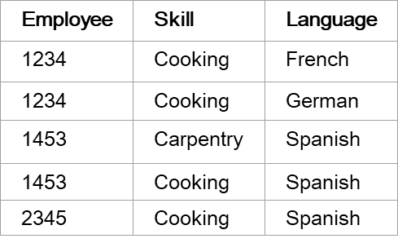
EXERCISE 3 (convert BCNF to 4NF)

Slide 50
4NF - Decomposition
Example 3 (Convert to 4NF)
Old Scheme → {Employee, Skill, ForeignLanguage}
New Scheme → {Employee, Skill}
New Scheme → {Employee, ForeignLanguage}
Employee
Skill
Employee
Language
1234
Cooking
1234
French
1453
Carpentry
1234
German
1453
Cooking
1453
Spanish
2345
Cooking
2345
Spanish

Slide 51
EXERCISE 4 (convert from 3NF to BCNF)
Address (Not in BCNF)
Scheme → {City, Street, ZipCode }
Key1 → {City, Street }
Key2 → {ZipCode, Street}
No non-key attribute hence 3NF
{City, Street} → {ZipCode}
{ZipCode} → {City}
Dependency between attributes belonging to a key
Old Scheme → {City, Street, ZipCode }
New Scheme1 → {ZipCode, Street}
New Scheme2 → {City, Street}
Loss of relation {ZipCode} → {City}
Alternate New Scheme1 → {ZipCode, Street }
Alternate New Scheme2 → {ZipCode, City}

Slide 52
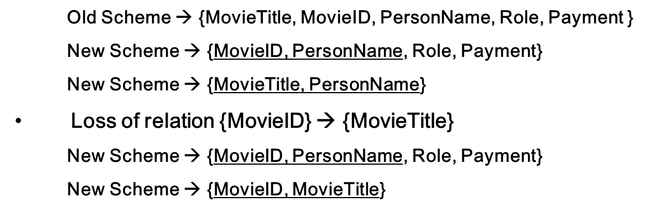
EXERCISE 5 (convert from 3NF to BCNF)
Movie (Not in BCNF)
Scheme → {MovieTitle, MovieID, PersonName, Role, Payment }
Key1 → {MovieTitle, PersonName}
Key2 → {MovieID, PersonName}
Both role and payment functionally depend on both candidate keys thus 3NF
{MovieID} → {MovieTitle}
Dependency between MovieID & MovieTitle Violates BCNF

Slide 53
EXERCISE 6 (convert from 3NF to BCNF)
Consulting (Not in BCNF)
Scheme → {Client, Problem, Consultant}
Key1 → {Client, Problem}
Key2 → {Client, Consultant}
No non-key attribute hence 3NF
{Client, Problem} → {Consultant}
{Client, Consultant} → {Problem}
Dependency between attributess belonging to keys violates BCNF
Old Scheme → {Client, Problem, Consultant}
New Scheme → {Client, Consultant}
New Scheme → {Client, Problem}

Slide 54

Fifth normal form
A relation is in 5NF if it is in 4NF and not having any join dependency and joining should be lossless
A relation that has a join dependency can not be divided into two (or more) relations such that the resulting tables can be combined to form the original table
5NF is satisfied when all the tables are broken into as many tables as possible in order to avoid redundancy.
5NF is also known as Project-join normal form (PJ/NF).
R -> R1, R2, R3 -> (R1 R2) R3 , R1 (R2 R3)

Slide 55
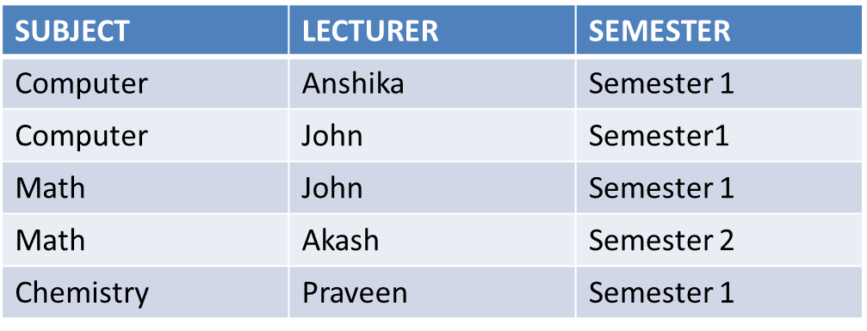
Example (convert to 5NF)
In the above table, John takes both Computer and Math class for Semester 1 but he doesn't take Math class for Semester 2. In this case, combination of all these fields required to identify a valid data.
Suppose we add a new Semester as Semester 3 but do not know about the subject and who will be taking that subject so we leave Lecturer and Subject as NULL. But all three columns together acts as a primary key, so we can't leave other two columns blank.
So to make the above table into 5NF, we can decompose it into three relations P1, P2 & P3:

Slide 56
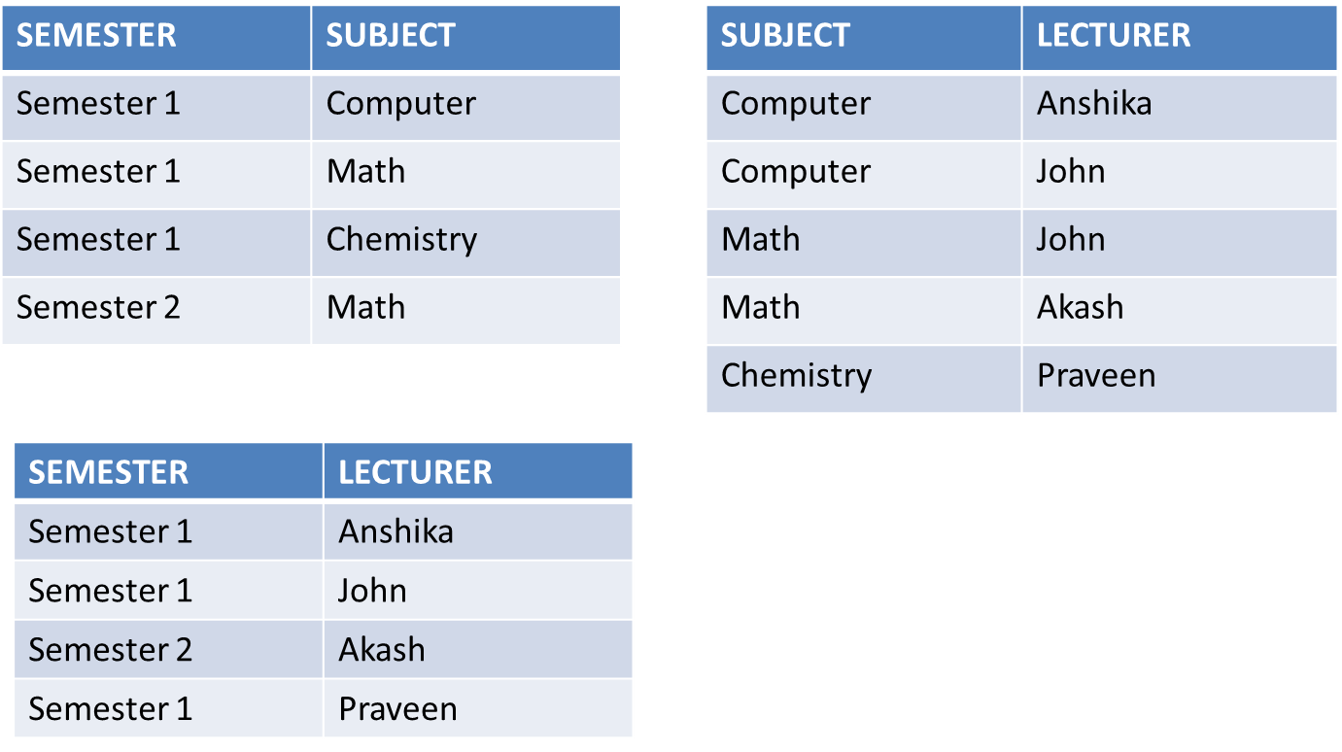
Example contd.

Slide 57
Properties of FDs
Closure Of Functional Dependency: Introduction
Closure Of Functional Dependency : Calculating Candidate Key
Closure Of Functional Dependency : Key Definitions

Slide 58
Closure Of Functional Dependency: Introduction
Step-1 : Add the attributes which are present on Left Hand Side in the original functional dependency.
Step-2 : Now, add the attributes present on the Right Hand Side of the functional dependency.
Step-3 : With the help of attributes present on Right Hand Side, check the other attributes that can be derived from the other given functional dependencies. Repeat this process until all the possible attributes which can be derived are added in the closure.

Slide 59
Example 1
Consider the table student_details having (Roll_No, Name,Marks, Location) as the attributes and having two functional dependencies.
FD1 : Roll_No-> Name, Marks
FD2 : Name -> Marks, Location
{Name}+ -{Name, Marks, location}
{marks}+ -

Slide 60
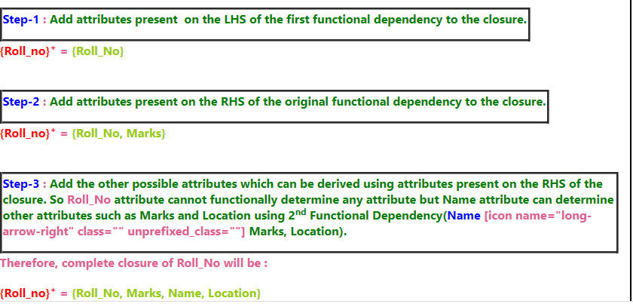
Example contd.

Slide 61
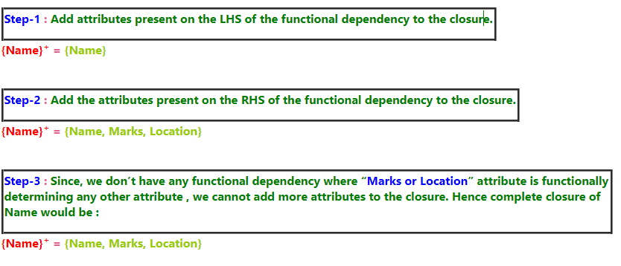
Example contd.

Slide 62
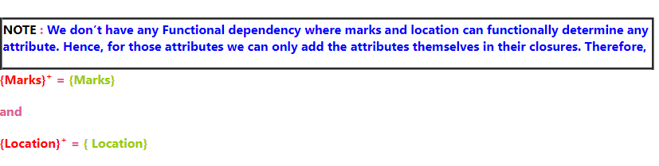
Example contd.

Slide 63
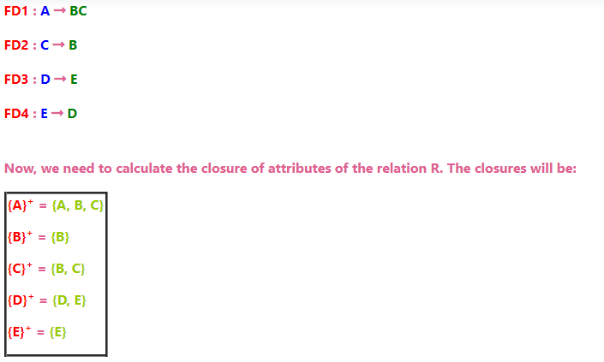
Example 2:
Consider a relation R(A,B,C,D,E) having below mentioned functional dependencies.

Slide 64
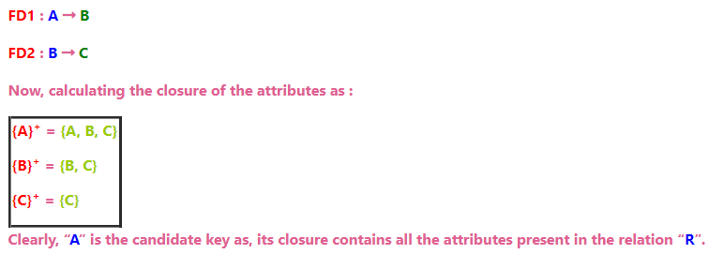
Closure Of Functional Dependency : Calculating Candidate Key
“A Candidate Key of a relation is an attribute or set of attributes that can determine the whole relation or contains all the attributes in its closure.“
Consider the relation R(A,B,C) with given functional dependencies :

Slide 65
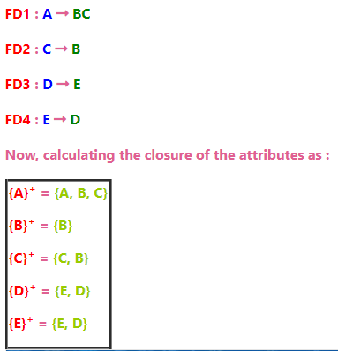
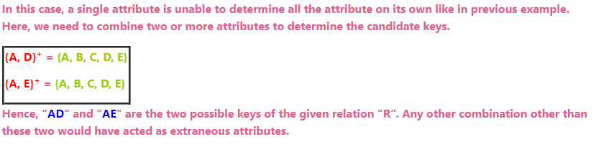
Example
Consider another relation R(A, B, C, D, E) having the Functional dependencies :

Slide 66
Closure Of Functional Dependency : Key Definitions
Prime Attributes : Attributes which are indispensable part of candidate keys. For example : “A, D, E” attributes are prime attributes in above example-2.
Non-Prime Attributes : Attributes other than prime attributes which does not take part in formation of candidate keys. For example.
Extraneous Attributes : Attributes which does not make any effect on removal from candidate key.

Slide 67
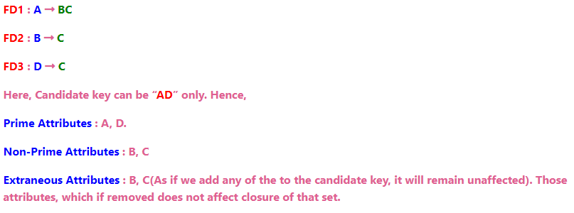
example
Consider the relation R(A, B, C, D) with functional dependencies :

Slide 68
Trival properties
https://www.geeksforgeeks.org/functional-dependency-and-attribute-closure/

